Slide 1
Thermochemistry
Day 4
Enthalpy and Heating Curves

Slide 2
Enthalpy Change (∆H)
The amount of energy absorbed or released as heat by a system when the pressure is constant.

Slide 3
Endothermic enthalpy change
Products
ΔH = Potential Energy
Reactants
Reaction Coordinate

Slide 4
Exothermic enthalpy change
Reactants
ΔH = Potential Energy
Products
Reaction Coordinate

Slide 5
Endothermic | Exothermic
Energy is absorbed | Energy is released
+q & +ΔH | -q & -ΔH
Break bonds | Form bonds
Energy appears in reactants (before the arrow) | Energy appears in products (after the arrow)

Slide 6
Endothermic |  | Exothermic
3 examples of the SAME information: |  | 3 examples of the SAME information:
NH₃ + H₂O → NH₄⁺ + OH⁻ | ΔH = +92kJ | N₂ + 3 H₂ → 2 NH₃ | ΔH = -324 kJ
positive = add(+) to reactants |  | negative = add(+) to products
energy + NH₃ + H₂O → NH₄⁺ + OH⁻ |  | N₂ + 3 H₂ → 2 NH₃ + energy
92 kJ + NH₃ + H₂O → NH₄⁺ + OH⁻ |  | N₂ + 3 H₂ → 2 NH₃ + 324 kJ

Slide 7
Heat of Reaction
(or enthalpy of reaction) is the energy involved in a chemical reaction.
heat of the reaction = [the sum of the heats of formation of the products] – [the sum of the heats of formation of the reactants]

Slide 8
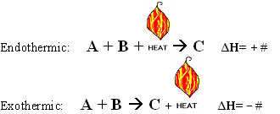
Thermochemical equation
chemical equation that includes the enthalpy change (the energy value)
Coefficients represent the number of moles.

Slide 9
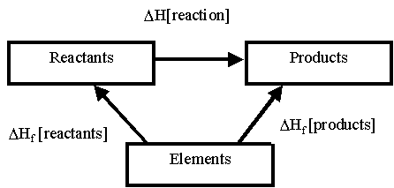
Heat of formation
ΔHº_{f} is called the heat of formation
Tells us how much energy was absorbed or gained to make 1 mole of that compound
Example: water (liquid) has a ΔHº_{f} = -286 kJ/mol
Elements in their natural state will have ∆H⁰_{f} of zero.

Slide 10
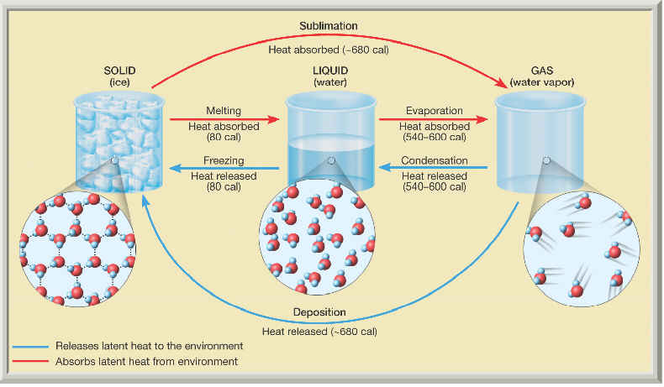
Energy: Phase Changes and Heat Curves
Change of physical state is also called a phase change. The temperature of a substance does not change during a phase change.

Slide 11
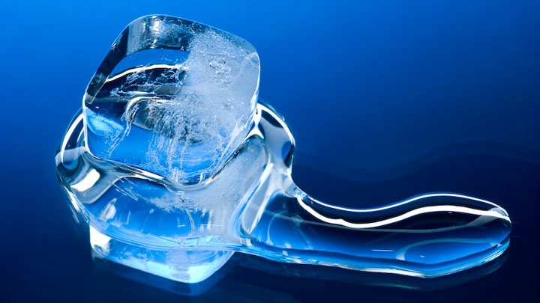
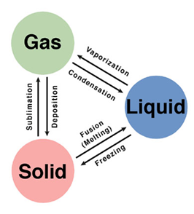
Phase changes
1. Melting – Phase change from a solid to a liquid.
Molecules speed up, move farther apart, and absorb heat energy. ENDO
2. Freezing– Phase change from a liquid to a solid.
Molecule slow down, move closer together and release heat energy. EXO

Slide 12
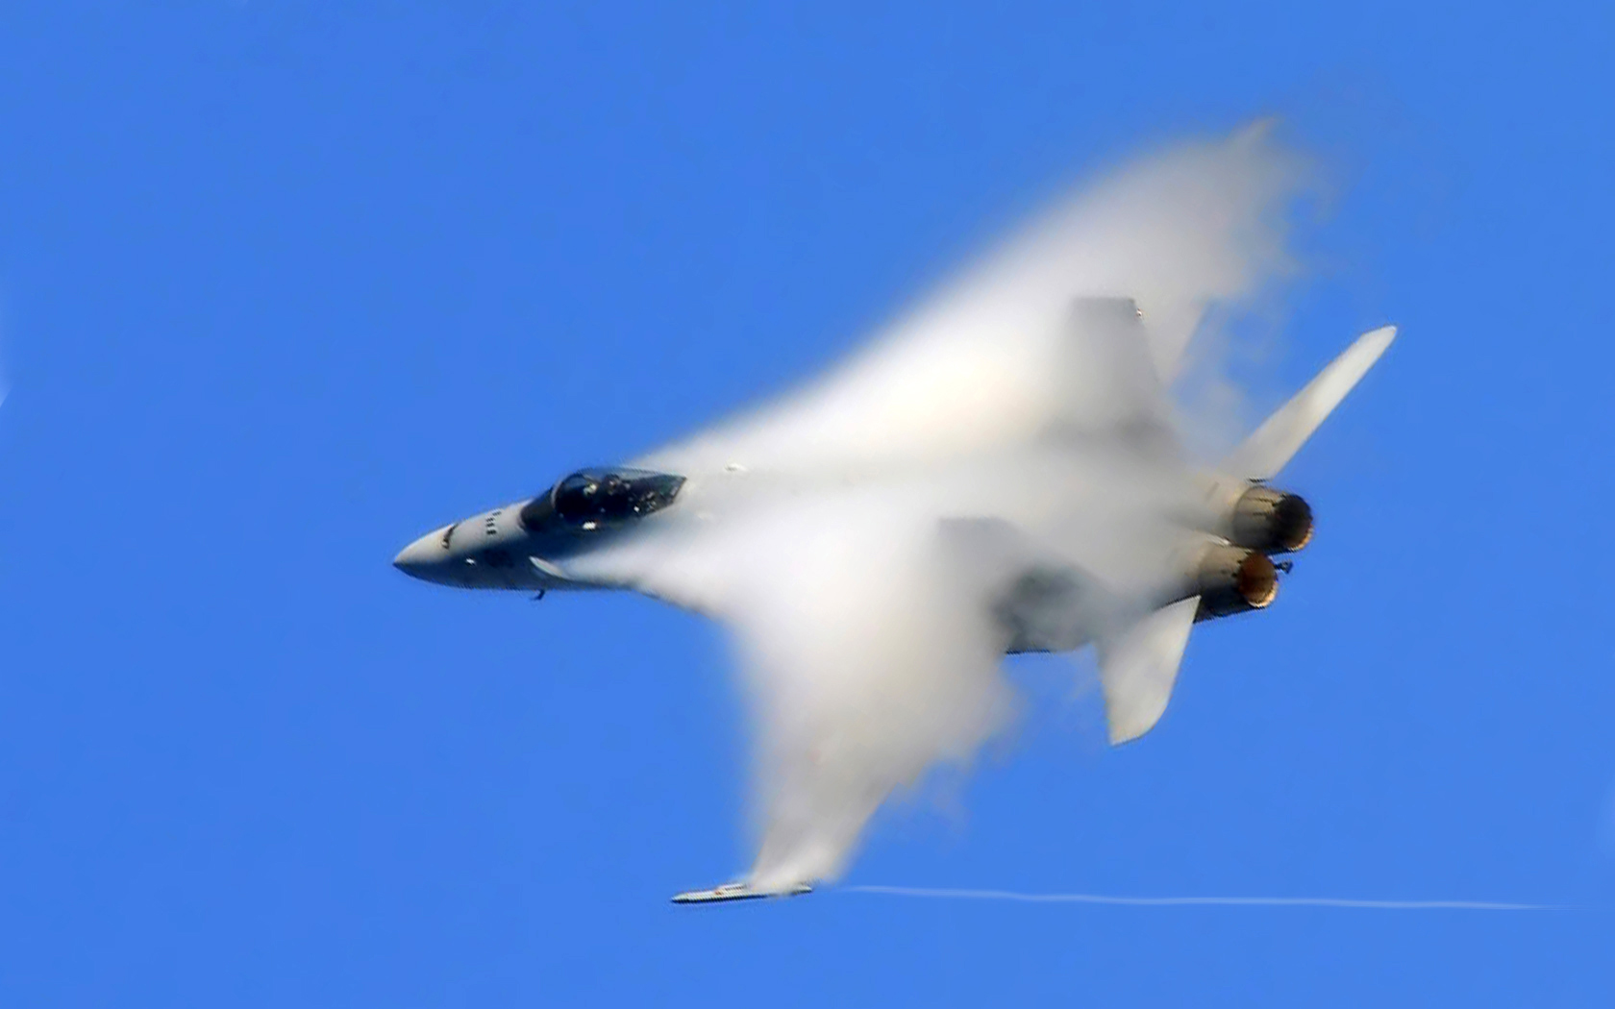
Phase changes
3. Vaporization - Phase change from a liquid to a gas.
Molecules speed up, move farther apart, and absorb heat energy. ENDO
4. Condensation– Phase change from a gas to a liquid.
Molecule slow down, move closer together and release heat energy. EXO

Slide 13
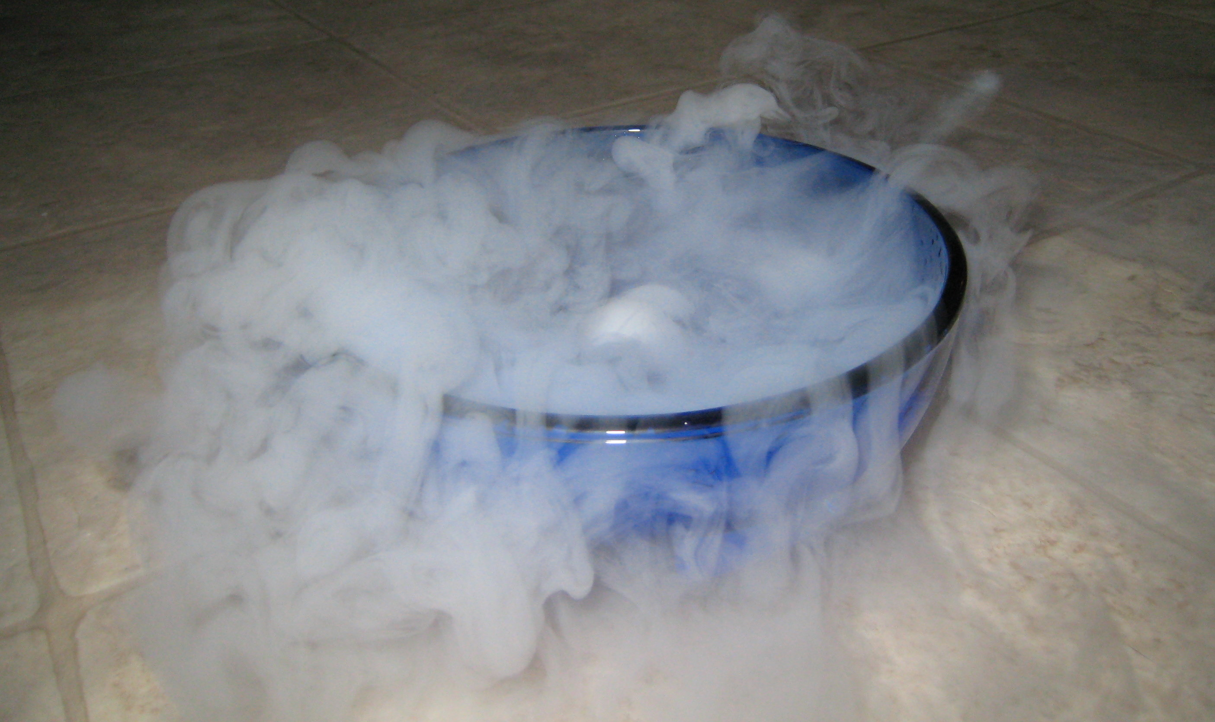
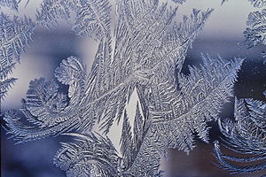
Phase changes
5. Sublimation– Phase change from a solid to a gas.
Molecules speed up, move farther apart, and absorb heat energy. ENDO
6. Deposition– Phase change from a gas to a solid.
Molecules slow down, move closer together and release heat energy. EXO

Slide 14
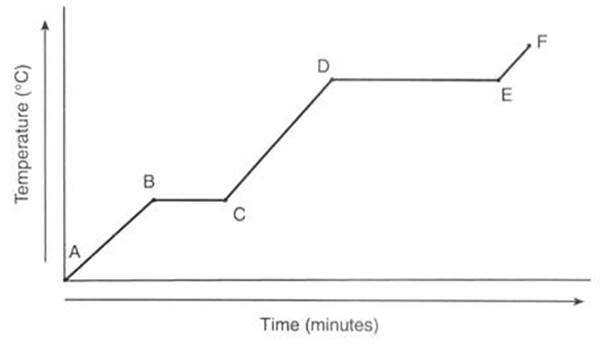
Heating curves
Heating/Cooling Curve shows energy changes. All matter follows curve when energy is added or lost.

Slide 15
Label the heating curve for water
100°C
0°C

Slide 16
Label the heating curve for water
vaporization
gas
100°C
condensation
liquid
melting
0°C
solid
freezing

Slide 17
Heating curves
Horizontal portions of curve indicate a physical state change. Notice temperature remains constant. However, there is a change in particle position resulting in a change in potential energy.

Slide 18
Heating curves
Slope portions show temperature change which indicates a change in kinetic energy as well.

Slide 19
Practice problems! On your paper!

